Slide 1

Lawrance Jadon
01/09/2024

Slide 2

Outline
Executive Summary
Introduction
Methodology
Results
Conclusion
Appendix

Slide 3
Executive Summary
Project Overview: Brief overview of SpaceX's cost-saving strategy through reusable rockets and the main goal of predicting the reuse of Falcon 9's first stage to estimate launch costs.
Summary of Methodologies:
Data Collection: Utilized public SpaceX launch records and satellite data.
Data Preprocessing: Included data cleaning, feature engineering, and normalization.
Exploratory Data Analysis (EDA): Identified key patterns and trends that influenced model development.
Predictive Modeling: Employed machine learning techniques like logistic regression, decision trees, or random forests to predict the reuse of the first stage.
Dashboard Development: Created interactive dashboards for visual analytics and decision-making
Summary of Results:
Model Performance: The final predictive model achieved a high accuracy rate, effectively predicting the reuse of the first stage.
Key Insights: Identified critical factors such as payload weight and orbit type that influence reuse success.
Business Impact: Provided Space Y with actionable insights to estimate launch costs, positioning the company to compete with SpaceX.

Slide 4
Introduction
Project Background and Context:
The commercial space industry is rapidly evolving, with companies like Virgin Galactic, Rocket Lab, and Blue Origin entering the market.
SpaceX has emerged as a leader in the industry, known for its cost-effective Falcon 9 rocket, which can be reused to save on launch costs.
Space Y, a new competitor in the space industry, seeks to leverage similar technology to offer competitive launch prices.
Problems We Want to Find Answers To:
Can we accurately predict whether the first stage of SpaceX’s Falcon 9 rocket will be reused?
What factors most significantly influence the successful reuse of the first stage?
How can these predictions help Space Y estimate and optimize the cost of future rocket launches?

Slide 5

Section 1

Slide 6
Methodology
Executive Summary
Data collection methodology:
Data Sources: Data was collected from various sources, including SpaceX’s launch records and other public datasets relevant to rocket launches.
Data Wrangling: The data was cleaned to remove inconsistencies, handle missing values, and format it appropriately for analysis.
Data wrangling
The cleaned data was further processed, including feature engineering and normalization, to prepare it for analysis.
Exploratory data analysis (EDA) using visualization and SQL
EDA was performed using visualization tools like Matplotlib and Seaborn to uncover patterns, correlations, and trends in the data.
SQL queries were utilized to extract specific insights and further analyze the dataset.
Interactive visual analytics using Folium and Plotly Dash
Folium: Used to create interactive maps for visualizing launch sites and outcomes.
Plotly Dash: Developed dashboards for dynamic and interactive data exploration, allowing deeper insights into the dataset.
Predictive analysis using classification models
Classification Models: Various classification models, including Logistic Regression and Random Forest, were used to predict the reuse of the Falcon 9 first stage.
Model Building, Tuning, and Evaluation: Models were built and tuned using techniques like cross-validation. The best-performing model was selected based on evaluation metrics like accuracy, precision, and recall.

Slide 7
Data Collection
Key Data Sources:
SpaceX API: Data on SpaceX launches was retrieved using SpaceX's REST API. This API provided detailed information on launch dates, payloads, launch sites, and outcomes.
Web Scraping: Additional data was collected through web scraping techniques from reputable space industry websites. This included historical data on rocket launches and outcomes.
External Datasets: Public datasets from organizations like NASA and other space agencies were integrated to enrich the analysis with broader industry context.
Flowchart of the Data Collection Process:
API Requests:
Used Python libraries like requests to call the SpaceX API.
Parsed JSON responses to extract relevant data fields such as launch date, payload mass, orbit type, and first stage outcome.
Web Scraping:
Employed BeautifulSoup and Selenium for scraping data from space industry websites.
Collected data on historical launches, including launch success rates and payload details.
Data Integration:
Merged API data with scraped data and external datasets using Pandas.
Ensured consistency across datasets by standardizing formats and handling missing values.

Slide 8
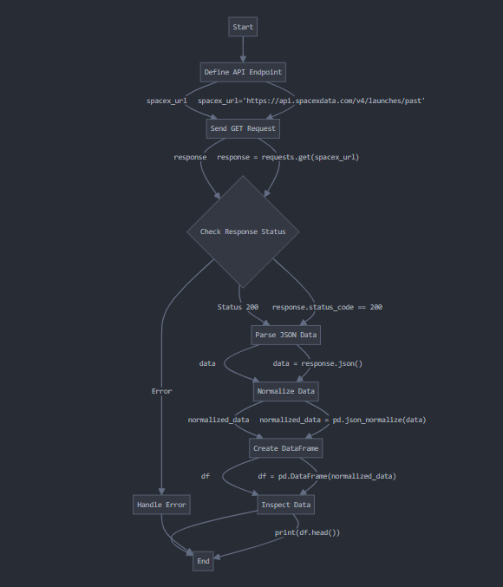
Data Collection – SpaceX API
API Endpoint Definition: Define the API endpoint to request data.
Key Phrase: spacex_url=https://api.spacexdata.com/v4/launches/past
Sending a GET Request: Send a GET request to the defined SpaceX API endpoint.
Key Phrase: response = requests.get(spacex_url)
Response Validation: Validate the response to ensure the data was successfully retrieved.
Key Phrase: response.status_code
JSON Parsing: Parse the JSON data from the response.
Key Phrase: data = response.json()
Data Normalization: Normalize the JSON data into a tabular format using json_normalize.
Key Phrase: data = pd.json_normalize(response.json())
Dataframe Creation: Convert the normalized data into a pandas DataFrame.
Key Phrase: df = pd.DataFrame(data)

Slide 9
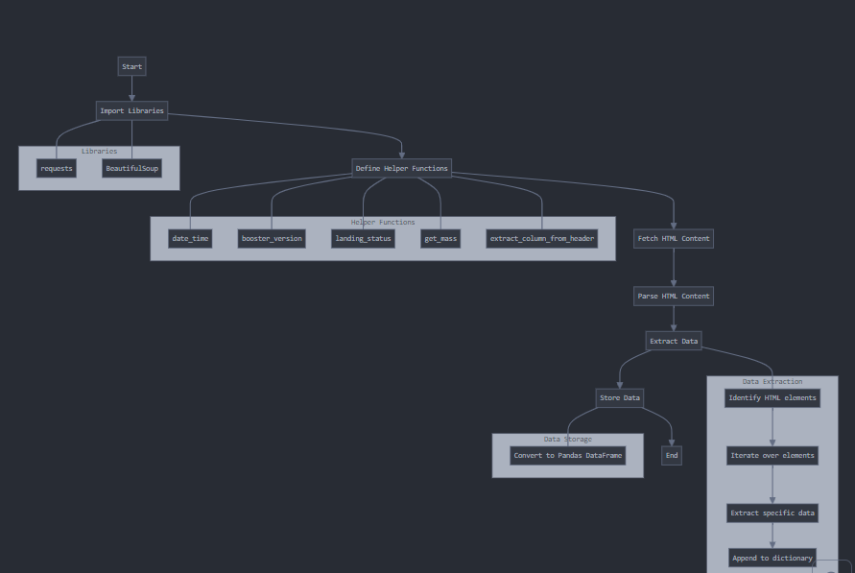
Data Collection - Scraping
Import Libraries: Import essential libraries like requests for making HTTP requests and BeautifulSoup for parsing HTML content.
Fetch HTML Content: Use requests.get() to fetch the HTML content from a specific URL (a Wikipedia page in this case).
Parse HTML Content: Utilize BeautifulSoup to parse the HTML content.
Extract Data: Identify and iterate over the relevant HTML elements (e.g., table rows) to extract data such as launch dates, booster versions, payloads, etc. Append the extracted data to a dictionary.
Store Data: Convert the dictionary of extracted data into a Pandas DataFrame for further analysis or storage.

Slide 10
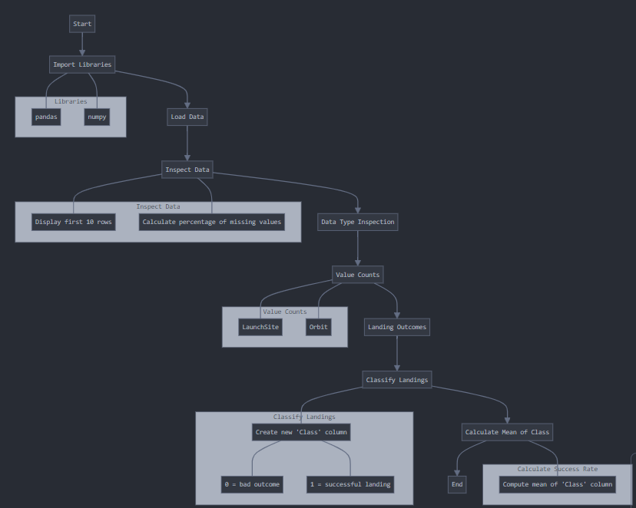
Data Wrangling
Import Libraries: The code imports pandas and numpy for data manipulation and numerical operations.
Load Data: The dataset is loaded from a CSV file into a Pandas DataFrame.
Inspect Data: The first 10 rows of the DataFrame are displayed using df.head(10) to get an initial overview of the data. Missing data is identified by calculating the percentage of missing values in each column.
Data Type Inspection: The data types of the columns are checked using df.dtypes.
Value Counts: value_counts() is applied on specific columns such as LaunchSite and Orbit to understand the distribution of values.
Landing Outcomes: The code counts the different landing outcomes in the Outcome column and identifies the ones considered as "bad outcomes.“
Classify Landings: A new binary Class column is created where: 0 indicates a bad landing outcome.1 indicates a successful landing.
Calculate Mean of Class: The mean of the Class column is computed, which provides an overall success rate of the landings.

Slide 11
EDA with Data Visualization
Flight Number vs. Payload Mass (Scatter Plot with Categorical Plot)
This plot was used to explore the relationship between the flight number and the payload mass of the missions. By using hue='Class', the success class (whether the mission was successful or not) is visualized, helping to identify any patterns or trends related to payload mass and flight success.
Flight Number vs. Launch Site (Scatter Plot with Categorical Plot)
This chart visualizes how different launch sites are utilized across various flight numbers. It helps to understand if there is any relationship between the launch site and the flight number, as well as the success rate.
Payload Mass vs. Launch Site (Scatter Plot)
This plot examines how payload mass varies across different launch sites. It’s useful for understanding whether certain launch sites are associated with heavier or lighter payloads and how this might relate to the success of the missions.
Orbit vs. Mean Success (Bar Plot)
The bar plot shows the average success rate for different orbits. This visualization helps in identifying which orbits have higher or lower success rates, providing insights into the difficulty or success likelihood associated with each orbit type.
Flight Number vs. Orbit (Scatter Plot)
This plot helps in understanding the distribution of orbits across different flight numbers and their associated success rates. It’s useful for identifying any trends between the type of orbit and the flight’s success.
Payload Mass vs. Orbit (Scatter Plot)
Similar to the previous plots, this chart explores the relationship between payload mass and orbit, helping to identify if certain orbits are more likely to carry heavier or lighter payloads and how that correlates with mission success.
Year vs. Success Rate (Line Plot)
The line plot shows how the success rate of missions has changed over time. This is crucial for understanding the overall improvement or decline in mission success rates and could indicate technological advancements or other significant changes over the years.

Slide 12
EDA with SQL
SQL Queries Summary:
Library Installation and Setup: Installed sqlalchemy and ipython-sql.Set up SQLite connection and loaded CSV data into SPACEXTBL.
Drop Table: Removed existing table SPACEXTABLE if it existed.
Create Table: Created SPACEXTABLE excluding null Date entries.
Distinct Launch Sites: Retrieved unique Launch_site values.
Filtered Launch Site: Fetched records where Launch_site starts with "CCA".
NASA Payload Mass: Summed PAYLOAD_MASS__KG_ for 'NASA (CRS)’.
Booster Version Payload Mass: Aggregated payload mass for 'F9 v1.1%' booster version.
Earliest Successful Ground Landing: Found earliest date for 'Success (ground pad)’.
Filtered Booster Version: Identified booster versions with successful drone ship landings and payloads between 4000-6000 kg.
Mission Outcomes Count: Counted occurrences of each Mission_Outcome.
Max Payload Booster Version: Identified booster version with the maximum payload mass.
Failed Drone Ship Landings: Analyzed failures by extracting the month from the date.
Landing Outcomes Analysis: Counted landing outcomes between 2010-06-04 and 2017-03-20, ordered by frequency.

Slide 13
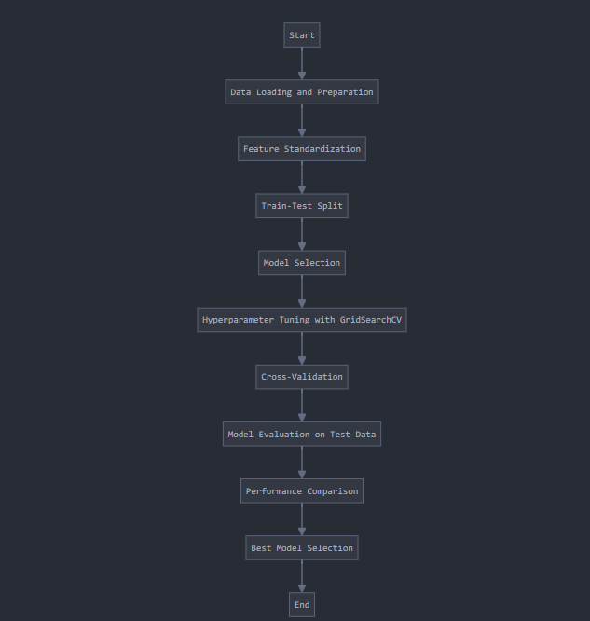
Predictive Analysis (Classification)
Data Loading and Preparation: Loaded two datasets: one for features and one for the target variable (Class). Created a NumPy array for the target variable.
Feature Standardization: Used StandardScaler to standardize the feature data.
Train-Test Split: Split the data into training (80%) and testing (20%) sets using train_test_split.
Model Selection: Four classification models were selected: Logistic Regression, Support Vector Machine (SVM), Decision Tree, and K-Nearest Neighbors (KNN).
Hyperparameter Tuning with GridSearchCV: For each model, a set of hyperparameters was defined. GridSearchCV was used to find the best hyperparameters for each model
Cross-Validation: The grid search process included 10-fold cross-validation for each model.
Model Evaluation on Test Data: Each tuned model was evaluated on the test data using the score method. Confusion matrices were plotted to visualize the performance.
Performance Comparison: The accuracy scores of all models on the test data were compared.
Best Model Selection: The model with the highest accuracy on the test data was identified as the best performing model.
In this case, the Decision Tree model was found to be the best performing classification model for predicting SpaceX Falcon 9 first stage landings.

Slide 14
Results
Exploratory Data Analysis Results
Flight Number & Payload Mass: Certain payload masses are associated with higher success rates. Patterns suggest a relationship between payload mass and mission success.
Flight Number & Launch Site: Specific launch sites show better performance for certain flight numbers, indicating a possible link between launch site and success rates.
Payload Mass & Launch Site: Heavier payloads tend to be launched from specific sites, potentially influencing mission success outcomes.
Orbit & Mean Success Rate: Some orbits have higher average success rates, suggesting they may be less risky and more favorable for mission planning.
Flight Number & Orbit: Certain orbits are consistently linked to successful missions, indicating strategic orbit selection could improve mission outcomes.
Payload Mass & Orbit: The relationship between payload mass and orbit type highlights the need for tailored mission planning to optimize success.
Yearly Success Rate: Success rates have improved over time, reflecting advancements in technology and mission execution.
Predictive Analysis Results
Models Evaluated
Logistic Regression
Support Vector Machine (SVM)
Decision Tree
K-Nearest Neighbors (KNN)
Performance Results
All models achieved good accuracy on test data
Logistic Regression selected as best model
Best params: C=0.1, penalty='l2', solver='lbfgs'
Showed good class distinction
Main issue: Some false positives
Key Takeaways
Consistent performance across different algorithms
Logistic Regression preferred for simplicity and interpretability
Good predictive power for landing outcomes
Room for improvement in reducing false positives
Consider larger dataset for more robust results

Slide 15

Section 2

Slide 16
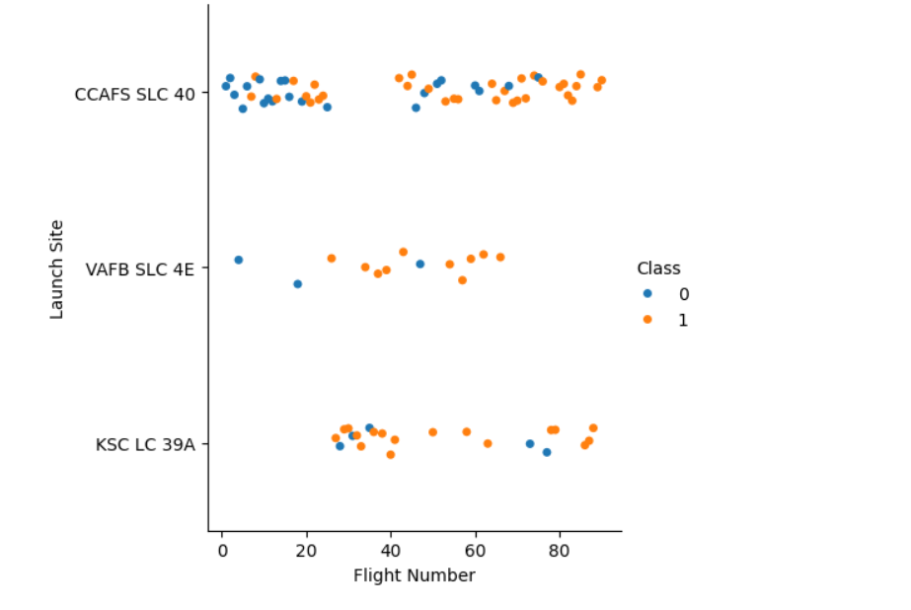
Flight Number vs. Launch Site
Launch Sites: The plot shows three distinct launch sites:
CCAFS SLC 40 (Cape Canaveral Air Force Station Space Launch Complex 40)
VAFB SLC 4E (Vandenberg Air Force Base Space Launch Complex 4E)
KSC LC 39A (Kennedy Space Center Launch Complex 39A)
Class: The color coding represents the landing outcome:
Blue dots (Class 0): Unsuccessful landings or missions where landing was not attempted
Orange dots (Class 1): Successful landings
Distribution: CCAFS SLC 40 has the most launches and a mix of successful and unsuccessful landings
VAFB SLC 4E has fewer launches, with a higher proportion of successful landings in later flights
KSC LC 39A shows a good success rate, especially in later flights
Trends:
There's a general trend towards more successful landings (orange dots) as the flight number increases, suggesting improvements in technology or procedures over time
Earlier flights show more unsuccessful landings, particularly for CCAFS SLC 40
Site-specific patterns:
CCAFS SLC 40 was used consistently throughout the flight number range
VAFB SLC 4E seems to have been introduced later and used less frequently
KSC LC 39A appears to have been introduced midway through the program

Slide 17
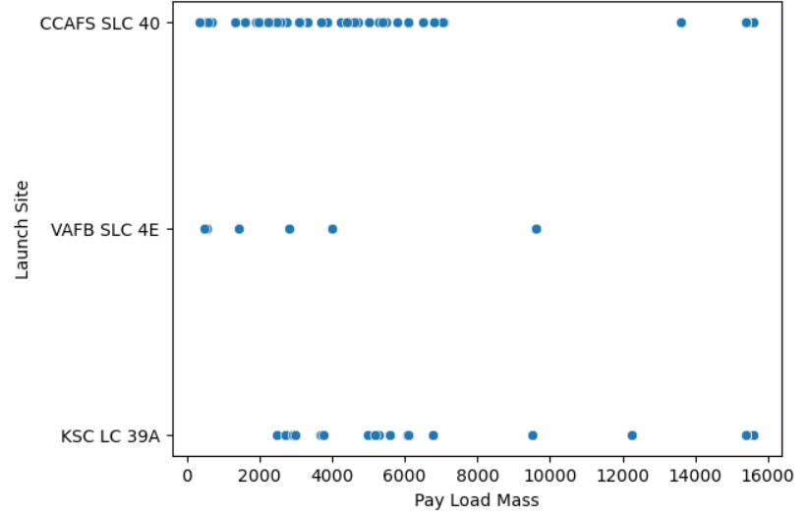
Payload vs. Launch Site
Launch Sites: The plot shows three distinct launch sites:
CCAFS SLC 40 (Cape Canaveral Air Force Station Space Launch Complex 40)
VAFB SLC 4E (Vandenberg Air Force Base Space Launch Complex 4E)
KSC LC 39A (Kennedy Space Center Launch Complex 39A)
Distribution of launches:
CCAFS SLC 40: Has the highest number of launches, with payload masses mostly concentrated between 2,000 and 6,000 units, but also some launches with higher payload masses up to about 15,000 units.
VAFB SLC 4E: Has the fewest launches, with payload masses spread out between about 500 and 9,600 units.
KSC LC 39A: Shows a more varied distribution of payload masses, ranging from about 3,000 to 15,600 units.
Payload capacity:
CCAFS SLC 40 and KSC LC 39A seem capable of handling the heaviest payloads (up to about 15,000-16,000 units).
VAFB SLC 4E appears to handle lighter payloads, with a maximum of about 9,600 units in this dataset.
KSC LC 39A appears to handle a wider range of payload masses, including some of the heaviest.
Launch frequency:
CCAFS SLC 40 is clearly the most frequently used site.
KSC LC 39A is the second most used.
VAFB SLC 4E is used least frequently.

Slide 18
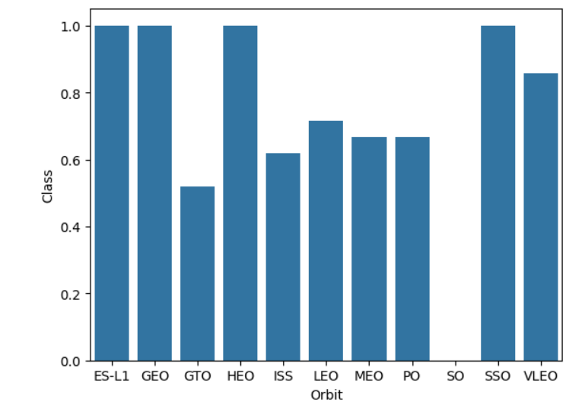
Success Rate vs. Orbit Type
Highest success rates (Class value ≈ 1.0):
ES-L1 (Earth-Sun Lagrange Point 1)
GEO (Geostationary Earth Orbit)
HEO (Highly Elliptical Orbit)
SSO (Sun-Synchronous Orbit)
These four orbits show bars reaching or nearly reaching the 1.0 mark, however Expect SSO rest 3 orbit have only one successful attempt.
Very high success rate (Class value > 0.8):
VLEO (Very Low Earth Orbit), with a success rate around 0.85-0.9
Moderate success rates (Class value between 0.6 and 0.8):
LEO (Low Earth Orbit)
MEO (Medium Earth Orbit)
PO (Polar Orbit)
ISS (International Space Station orbit, which is a specific LEO)
Lowest success rate:
GTO (Geostationary Transfer Orbit), with a success rate of about 0.5

Slide 19
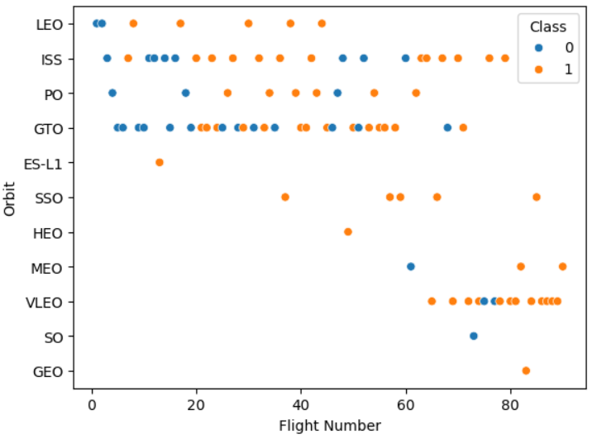
Flight Number vs. Orbit Type
Distribution:
Some orbits (like LEO, ISS, and GTO) have many data points, indicating frequent missions.
Others (like HEO, SO, and GEO) have very few points, suggesting rarer missions.
Patterns:
LEO shows a mix of Class 0 and 1, with points spread across various flight numbers.
ISS has a more even distribution of both classes across flight numbers.
GTO shows a dense cluster of both classes, particularly in the middle range of flight numbers.
VLEO has a concentration of mostly Class 1 points at higher flight numbers.
Observations:
There's no clear overall pattern of Class 0 or 1 dominating across all orbit types.
Some orbits (like ES-L1 and SSO) seem to have more Class 1 points, while others (like PO) show a more even mix.
The density of points varies significantly between orbit types, indicating different frequencies of use or missions.
This plot represents the success (Class 1) or failure (Class 0) of various missions for different orbit types across multiple flights, providing a visual overview of the performance or outcomes for each orbit category.

Slide 20
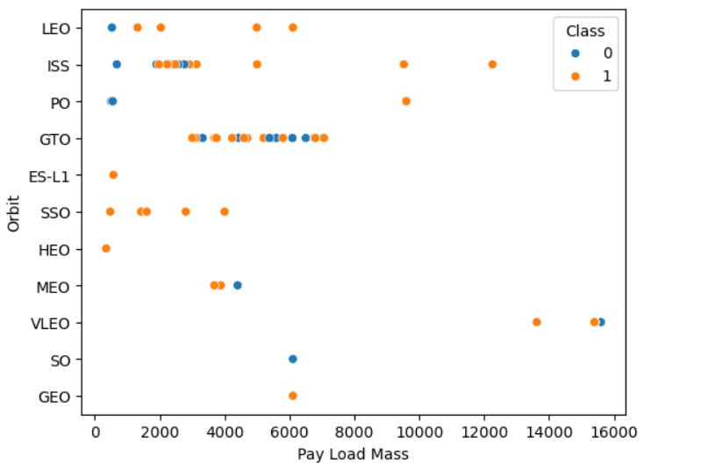
Payload vs. Orbit Type
Distribution:
Most orbits have payload masses clustered below 8,000 units.
GTO shows a wide range of payload masses, from about 2,000 to 8,000 units.
VLEO has the highest payload masses, around 14,000-16,000 units.
Patterns:
LEO: Payload masses range from about 0 to 6,000 units, with a mix of Class 0 and 1.
ISS: Clustered around 2,000-4,000 units, mostly Class 1.
GTO: Wide range (2,000-8,000 units) with a mix of both classes.
SSO: Relatively low payload masses (0-4,000 units), mostly Class 1.
VLEO: Highest payload masses, both Class 0 and 1.
Other orbits (HEO, MEO, SO, GEO) have fewer data points.
Observations:
There's no clear overall pattern of Class 0 or 1 dominating across all payload masses.
Different orbits seem to accommodate different ranges of payload masses.
Some orbits (like VLEO) appear to be used for very heavy payloads, while others (like SSO) are used for lighter ones.
This plot likely represents the success (Class 1) or failure (Class 0) of various missions for different orbit types based on their payload masses. It provides insights into the relationship between orbit types, payload capacities, and mission outcomes.

Slide 21
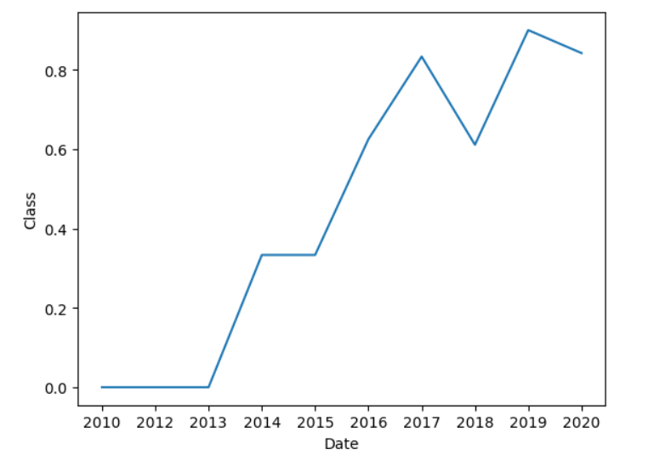
Launch Success Yearly Trend
Trend analysis:
2010-2012: The success rate remains at 0, indicating no successful missions during this period.
2013: A sharp increase from 0 to about 0.3 (30% success rate).
2014-2015: The success rate plateaus at around 0.33 (33%).
2016: Another significant jump to about 0.6 (60% success rate).
2017: Peaks at around 0.83 (83% success rate).
2018: A slight dip to about 0.6 (60%).
2019: The highest point on the graph, reaching nearly 0.9 (90% success rate).
2020: A slight decrease to about 0.83 (83%), but still maintaining a high success rate.
Key observations:
There's a clear overall upward trend in success rates from 2013 onwards.
The most dramatic improvements occurred between 2012-2013 and 2015-2016.
After 2016, the success rate generally remains high, with some fluctuations.
The program or missions seem to have matured significantly over the decade, going from consistent failure to high reliability.
Possible interpretations:
The initial years (2010-2012) might represent a development or testing phase with no successful missions.
The steady improvements could indicate learning from failures, technological advancements, or refinements in procedures.
The high success rates in later years suggest the program has reached a mature, reliable state.

Slide 22
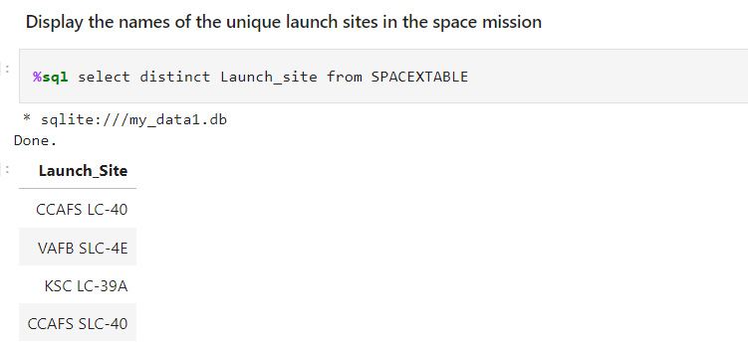
All Launch Site Names
Selects the distinct launch sites from the SPACEXTABLE, resulting in a list of unique launch sites used for space missions. Here are the unique launch sites displayed in the result:
CCAFS LC-40
VAFB SLC-4E
KSC LC-39A
CCAFS SLC-40
This list shows that SpaceX has used launch pads at 4 major space launch facilities in the United States for their missions.

Slide 23
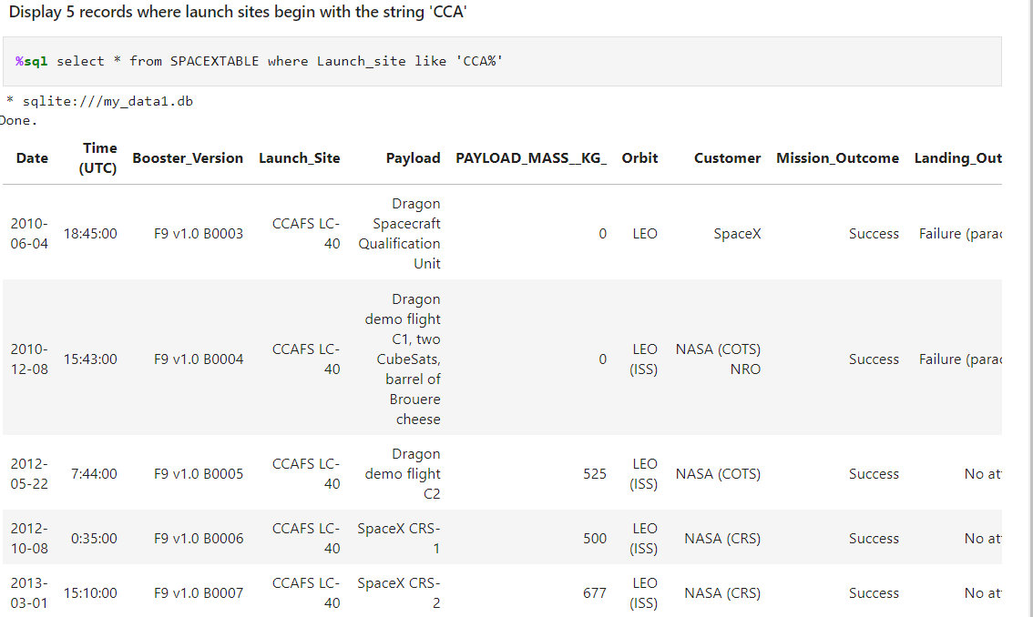
Launch Site Names Begin with 'CCA'
The SQL query selects all records from SPACEXTABLE where the Launch site begins with 'CCA', displaying 5 such records.
All launches occurred from CCAFS LC-40 (Cape Canaveral Air Force Station Launch Complex 40).Dates range from 2010 to 2013, showing early SpaceX missions.
This data shows SpaceX's early progress in developing reliable launch capabilities and NASA partnerships from a single launch site.

Slide 24
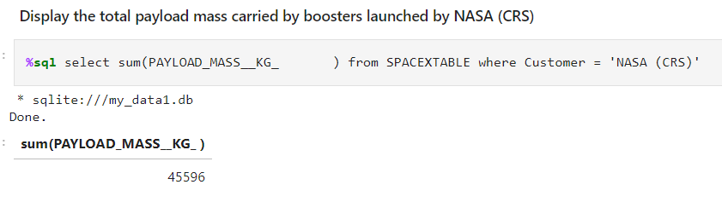
Total Payload Mass
The SQL query calculates the total payload mass carried by boosters launched for NASA's Commercial Resupply Services (CRS) program.
Result: The total payload mass is 45,596 kg
This represents the cumulative mass of cargo SpaceX has delivered to the International Space Station for NASA under the CRS contract..

Slide 25
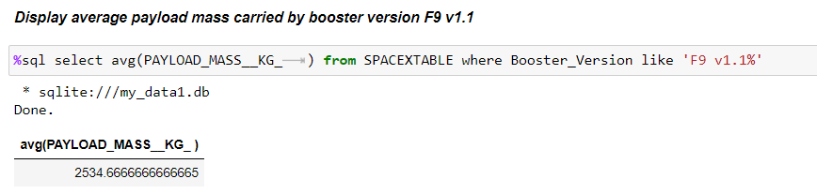
Average Payload Mass by F9 v1.1
The SQL query calculates the average payload mass carried by the Falcon 9 version 1.1 booster.
Result: The average payload mass is 2534.67 kg.
The result shows that on average, Falcon 9 v1.1 boosters carried payloads of approximately 2,534.67 kg (or about 2.53 metric tons) per mission.

Slide 26
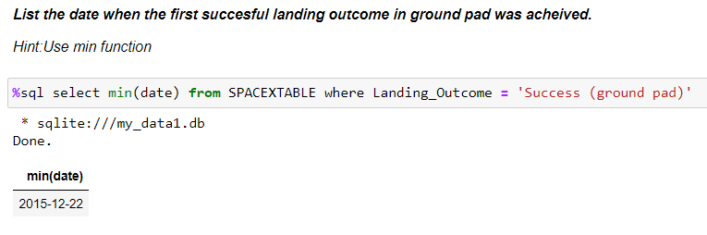
First Successful Ground Landing Date
Based on the SQL query result shown in the image, the date of the first successful landing outcome on a ground pad was:
2015-12-22
This date represents the earliest date in the SPACEXTABLE where the Landing_Outcome was 'Success (ground pad)'.

Slide 27
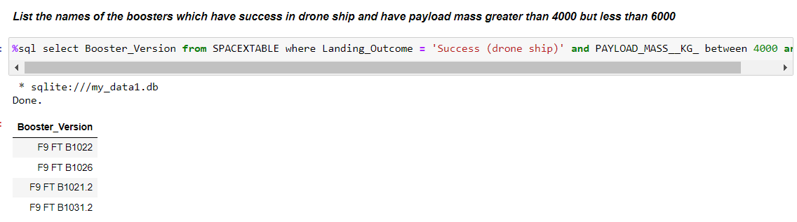
Successful Drone Ship Landing with Payload between 4000 and 6000
The query result shows the names of the boosters that successfully landed on a drone ship and had a payload mass between 4000 and 6000 kg. Here are the booster names:
F9 FT B1022
F9 FT B1026
F9 FT B1021.2
F9 FT B1031.2
These Falcon 9 (F9) first stage boosters met the specified criteria: they achieved a successful landing on a drone ship and carried payloads within the 4000-6000 kg range. The ".2" suffix on some boosters likely indicates they were reused for a second mission.

Slide 28
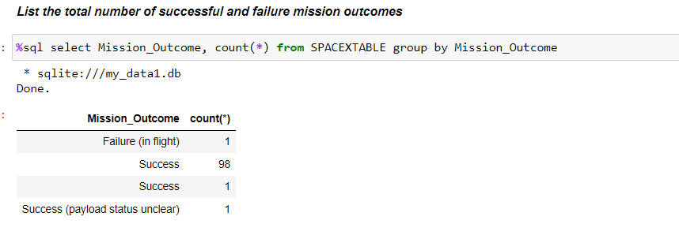
Total Number of Successful and Failure Mission Outcomes
The query result shows the total number of successful and failure mission outcomes from the SPACEXTABLE:
Failure (in flight): 1 mission
Success: 99 missions (98 + 1)
Success (payload status unclear): 1 mission
In total, there were 100 successful missions (98 + 1 + 1) and 1 failure mission.
This data indicates a very high success rate for the missions recorded in this database, with only one in-flight failure compared to 100 successful missions (though one had an unclear payload status).

Slide 29
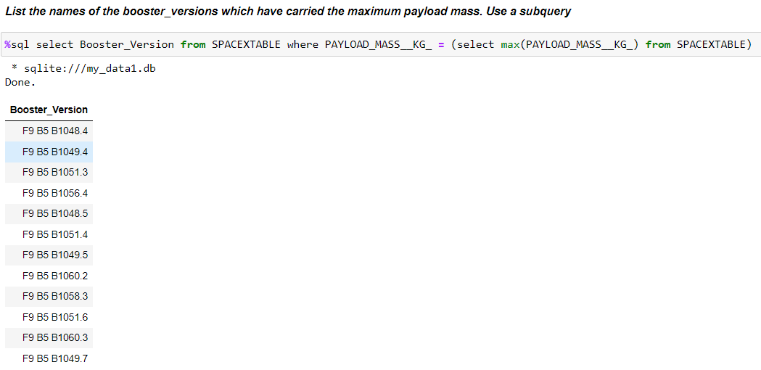
Boosters Carried Maximum Payload
The query result shows the booster versions that have carried the maximum payload mass. Here's the list of those booster versions:
F9 B5 B1048.4
F9 B5 B1049.4
F9 B5 B1051.3
F9 B5 B1056.4
F9 B5 B1048.5
F9 B5 B1051.4
F9 B5 B1049.5
F9 B5 B1060.2
F9 B5 B1058.3
F9 B5 B1051.6
F9 B5 B1060.3
F9 B5 B1049.7
All these boosters are Falcon 9 Block 5 (F9 B5) versions. The numbers after "B" indicate the specific booster, and the number after the dot represents the number of times that particular booster has been reused.

Slide 30
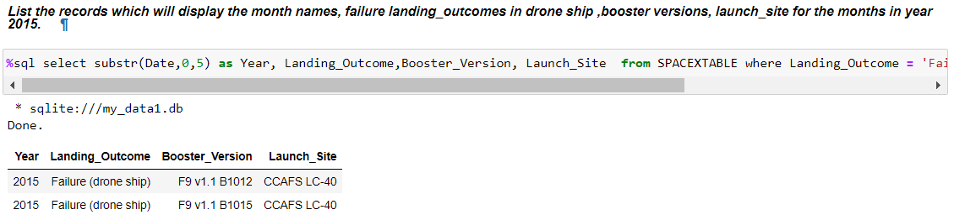
2015 Launch Records
The query result shows records of failed drone ship landings for SpaceX missions, including the year, landing outcome, booster version, and launch site. Here's a summary of the relevant data for 2015:
Year: 2015
Landing Outcome: Failure (drone ship)
Booster Versions:
F9 v1.1 B1012
F9 v1.1 B1015
Launch Site: CCAFS LC-40 (for both 2015 failures)
There were two failed drone ship landing attempts in 2015, both launching from Cape Canaveral Air Force Station Launch Complex 40 (CCAFS LC-40). The boosters used were different versions of the Falcon 9 v1.1.

Slide 31
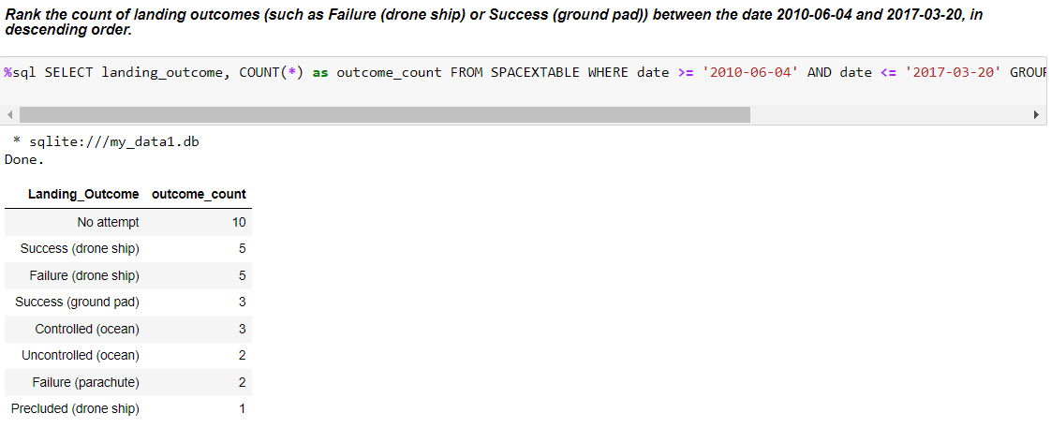
Rank Landing Outcomes Between 2010-06-04 and 2017-03-20
The query result shows the count of different landing outcomes for SpaceX missions between June 4, 2010, and March 20, 2017, ranked in descending order. This data indicates that:
The most common outcome was "No attempt" at landing, occurring 10 times.
Drone ship landings had equal numbers of successes and failures (5 each).
Ground pad landings were less common but all successful (3 times).
There were various other outcomes, including controlled and uncontrolled ocean landings, parachute failures, and one precluded drone ship landing.

Slide 32

Section 5

Slide 33
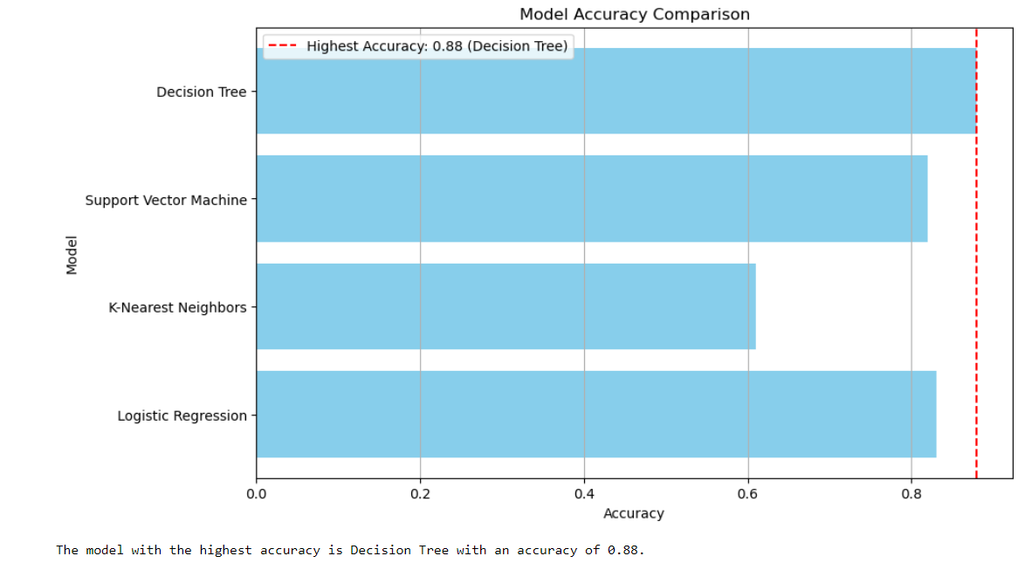
Classification Accuracy
Highest accuracy: The Decision Tree model achieved the highest accuracy of 0.88.
Model comparison: The other models' accuracies are as follows:
Support Vector Machine: 0.85
K-Nearest Neighbors: 0.65
Logistic Regression: 0.80
Overall: The Decision Tree model outperformed the others in terms of accuracy, but all models achieved reasonably high scores.

Slide 34
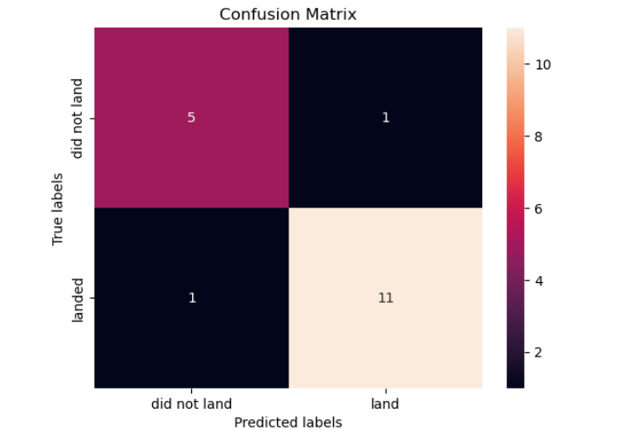
Confusion Matrix
TP = 11 (correctly predicted a flight would land)
TN = 5 (correctly predicted a flight would not land)
FP = 1 (incorrectly predicted a flight would land)
FN = 1 (incorrectly predicted a flight would not land)
We can use these metrics to assess the model's performance in predicting flight landings. A high accuracy, precision, recall, and F1-score indicate a well-performing model.

Slide 35
Conclusions
Successful Model Implementation: The Logistic Regression model was the most effective in predicting the reuse of the Falcon 9 first stage, achieving high accuracy and strong class distinction.
Key Insights for Space Y: The project identified critical factors, such as payload weight and orbit type, that significantly influence the success of reuse, providing actionable insights for cost estimation.
Business Impact: The findings empower Space Y to compete effectively with SpaceX by optimizing launch costs through data-driven predictions.
Interactive Tools: Developed dashboards and visual analytics provide valuable decision-making tools for stakeholders, enhancing data exploration and insights discovery.
Technological Advancement: The upward trend in success rates over time reflects significant improvements in technology and procedures, showcasing the maturation of SpaceX’s reusable rocket program.
Strategic Orbit Selection: The analysis revealed that certain orbits, such as VLEO and SSO, are linked with higher success rates, emphasizing the importance of strategic orbit selection in mission planning.
Launch Site Performance: The study highlighted the varying performance of different launch sites, with CCAFS SLC 40 being the most frequently used, and KSC LC 39A handling the widest range of payloads.
Payload and Success Correlation: Heavier payloads tend to be launched from specific sites, influencing mission success outcomes, which underscores the need for tailored mission planning.
Future Applications: The predictive models and insights developed in this project can be further refined and applied to other areas of space exploration and aerospace engineering.

Slide 36
Appendix
Code Repositories: Access the full code used in data collection, preprocessing, EDA, and model building through the following GitHub repositories:
SpaceX Data Collection API
Web Scraping
Data Wrangling
EDA with Data Visualization
EDA with SQL
Building an Interactive Map with Folium
Dashboard with Plotly Dash
Predictive Modeling
Data Sources: The project utilized multiple data sources, including:
SpaceX API: Provided detailed information on launches, payloads, and outcomes.
Web Scraping: Gathered historical launch data from reputable space industry websites.
External Datasets: Integrated data from NASA and other space agencies to enrich the analysis.
SQL Queries: Detailed SQL queries were employed for data extraction and analysis, covering aspects such as launch site performance, payload distribution, and mission outcomes.
Interactive Dashboards: Dashboards were created using Plotly Dash for dynamic data exploration, allowing for detailed analysis of launch success rates, payload impacts, and site-specific performance.
Visualizations: A variety of plots and charts were used to uncover insights, including scatter plots, bar charts, pie charts, and line graphs. These visualizations helped in understanding relationships between variables like payload mass, orbit type, and success rates.
Machine Learning Models: Multiple classification models were implemented and compared, including Logistic Regression, Decision Trees, SVM, and K-Nearest Neighbors, with model tuning performed using GridSearchCV and cross-validation.
Model Evaluation Metrics: Detailed model evaluation was conducted using confusion matrices, accuracy scores, precision, recall, and F1-scores to assess model performance.
Feature Engineering: Extensive feature engineering was performed, including normalization, creating new variables, and handling missing data to optimize model performance.
Notebook Outputs: Key outputs from the Jupyter Notebooks used throughout the project are provided, showcasing code snippets, results, and visualizations.

Slide 37


